Slide 1
Figure 2-1

Slide 2
Application that leverage LLM’s and other FMs
Tools to build with LLM’s and other FMs
Infrastructure for FM Training & Inferences
Notes:
Top layer of the stack: Application that leverage LLM’s and other FMs
Middle layer of the stack: Tools to build with LLM’s and other FMs
Bottom layer of the stack: Infrastructure for FM Training & Inferences

Slide 3
Figure 2-2

Slide 4
Infrastructure for FM Training & Inferences
GPUs
Trainium
Inferentia
SageMaker
Ultraclusters
EFA
EC2 Capacity Blocks
Nitro
Neuron

Slide 5
Figure 2-3

Slide 6
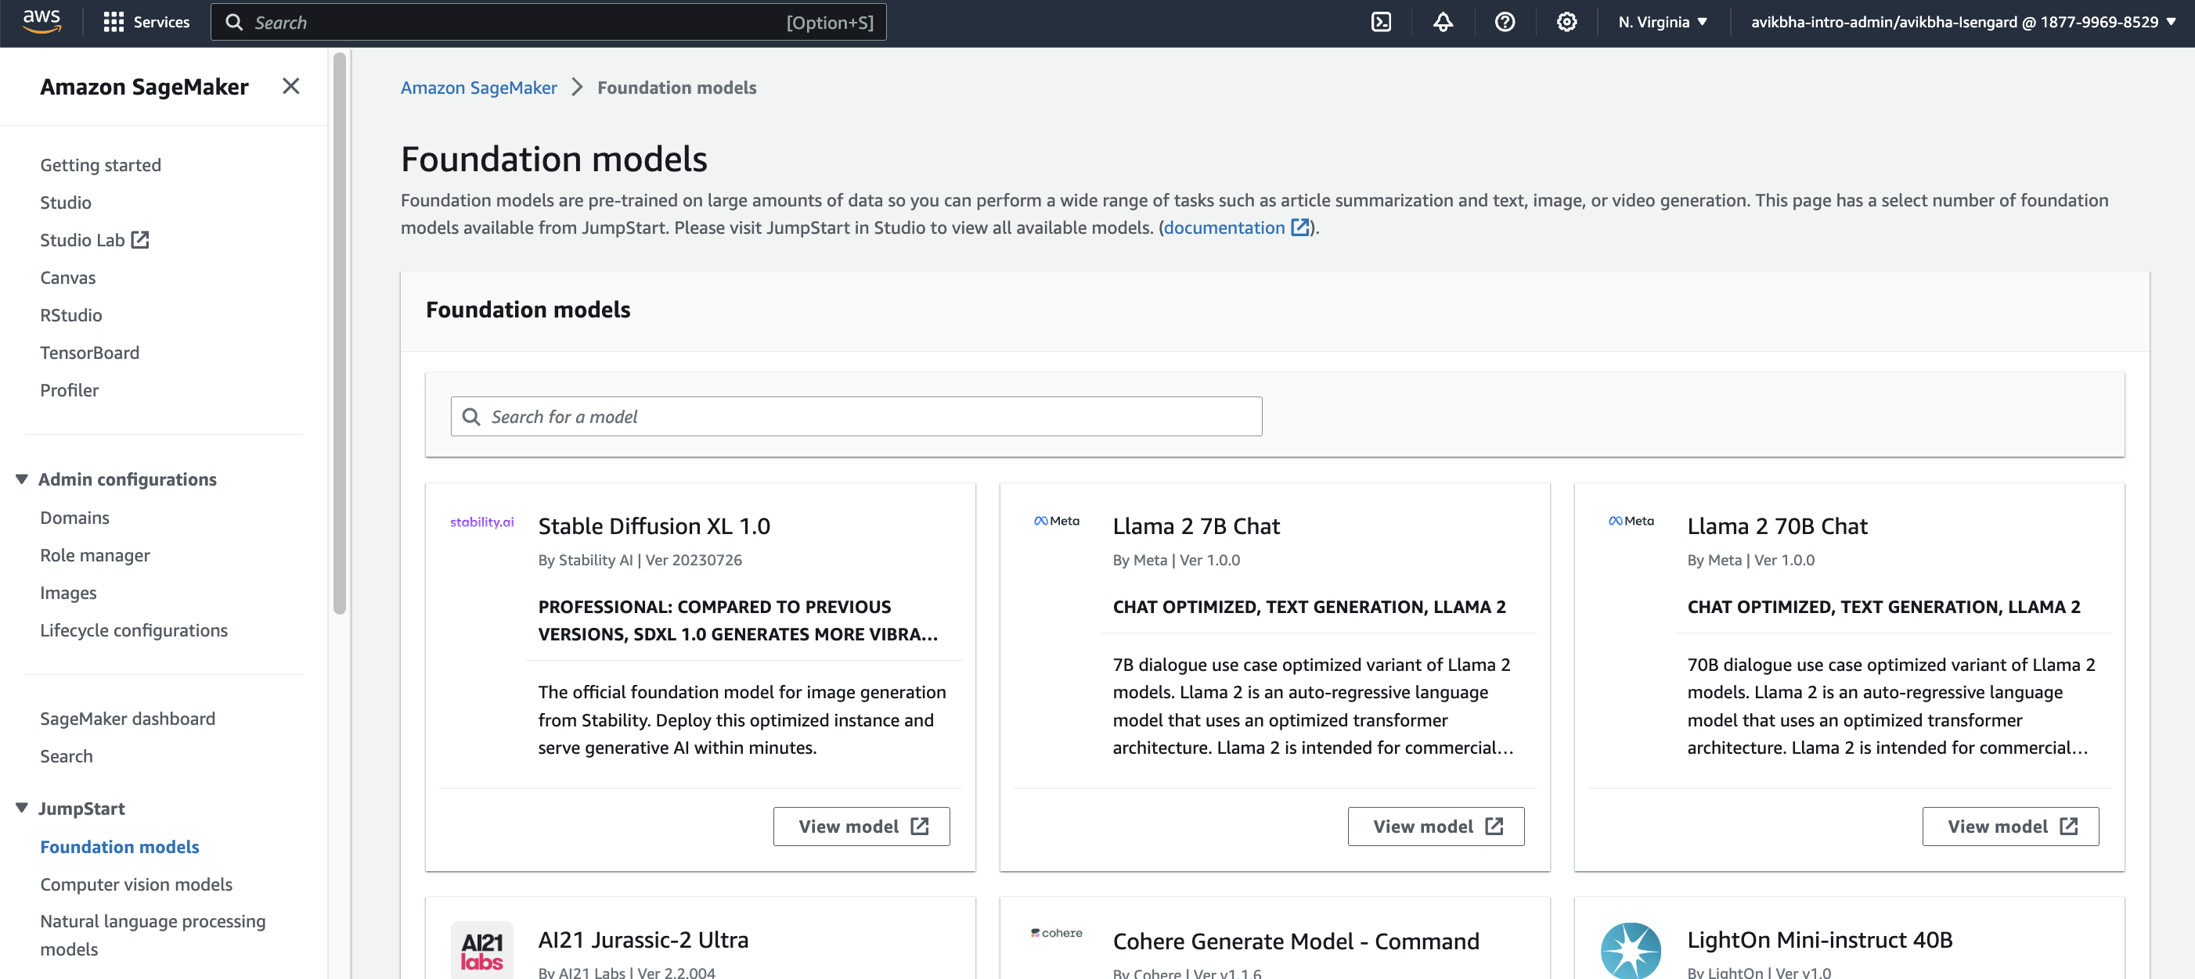

Slide 7
Figure 2-4 & 2-5

Slide 8
Tools to build with LLM’s and other FMs
Amazon Bedrock
Amazon Bedrock advanced features
Application that leverage LLM’s and other FMs
Amazon Q

Slide 9
Figure 2-6

Slide 10
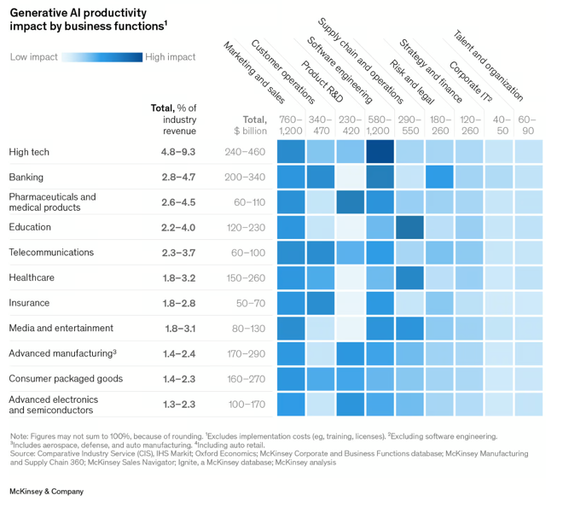

Slide 11
Figure 2-7

Slide 12
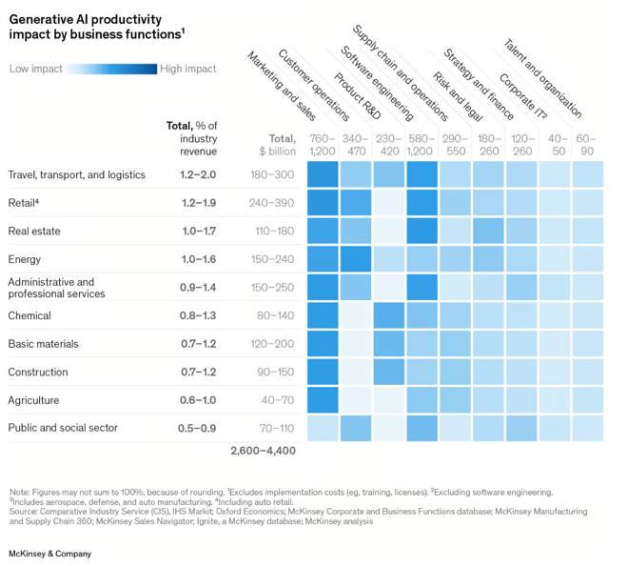

Slide 13
Figure 2-8

Slide 14
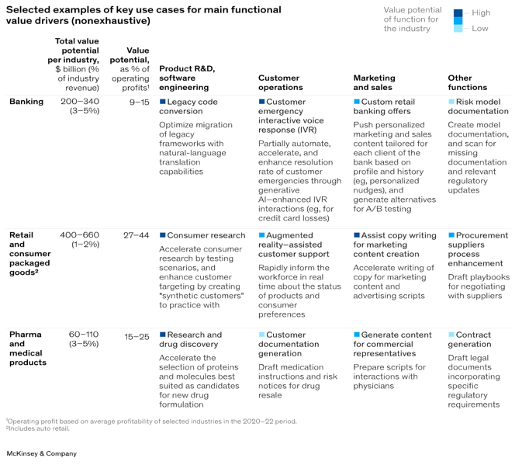

Slide 15
Figure 2-9

Slide 16
Monitoring
Generate event & feedback
Automate the fly wheel
Identify the business goals
Define the use cases
Define the Generative AI problem statement
Use cases
Data strategy
Right choice of Foundation Models
Deployment
Monitoring
Model Evaluation & Interpretation
Deployment
Integrate with Generative AI Applications
testing strategy
Data identification
Data acquisition
Data Preparation
Identify the evaluation tools
Measure qualitatively and quantitatively
Compare & interpretation
Identify the right models with attributes ( like context window )
In-context learning strategy
Align and adapt model ( pre-training/ fine-tuning )
Notes:
How managing use cases is important for Generative AI project lifecycle on the below points
Identify the business goals
Define the use cases
Define the Generative AI problem statement

Slide 17
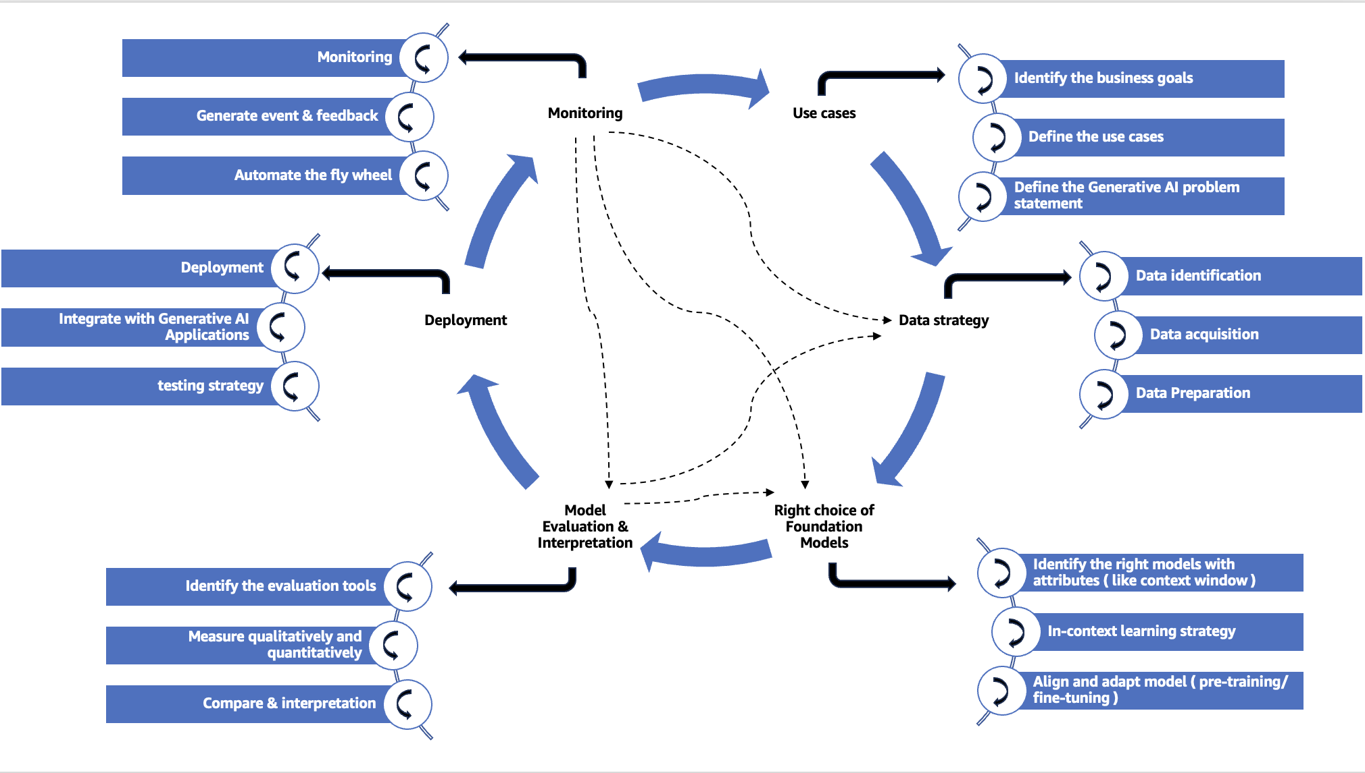
People
Process
Tools and Technologies

